Slide 1



Slide 2


Slide 3







HEADER
MOBILE
480px
BUY NOW
HERO
PRODUCTS
PRODUCT
ABOUT
TABLET
768px
ADVANTAGES
READ MORE
GALLERY
LOCATIONS
CUSTOMERS REVIEWS
DESKTOP
1200px
CONTACTS
FRANCHISE
FOOTER

Slide 4

Matcha tea
Vanilla honey
Choco caramel

Slide 5
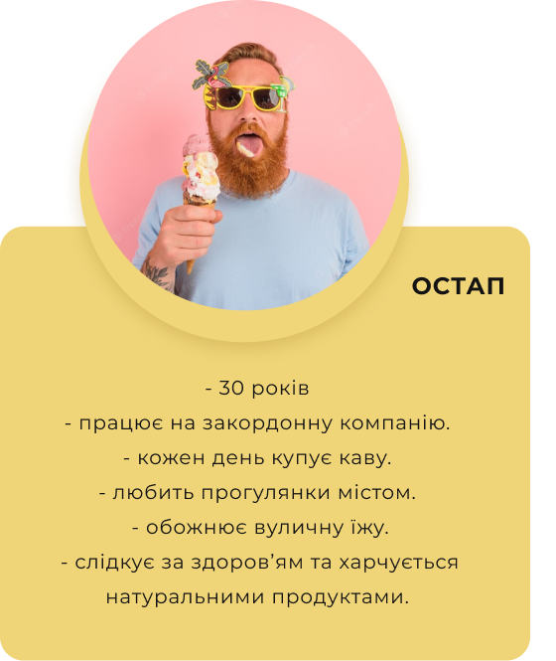
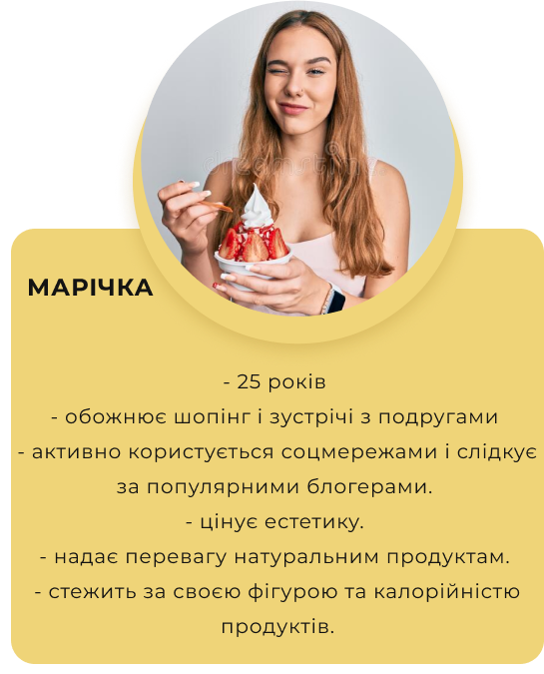


Slide 6
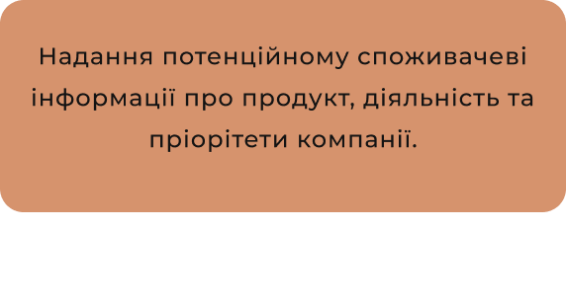





Slide 7

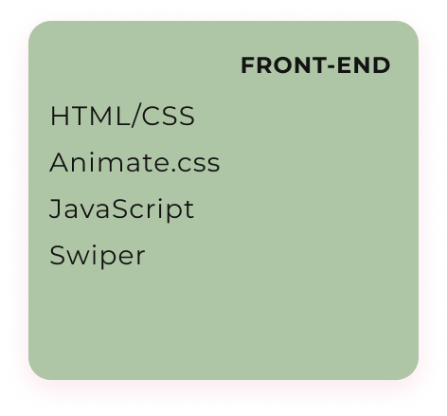




Slide 8

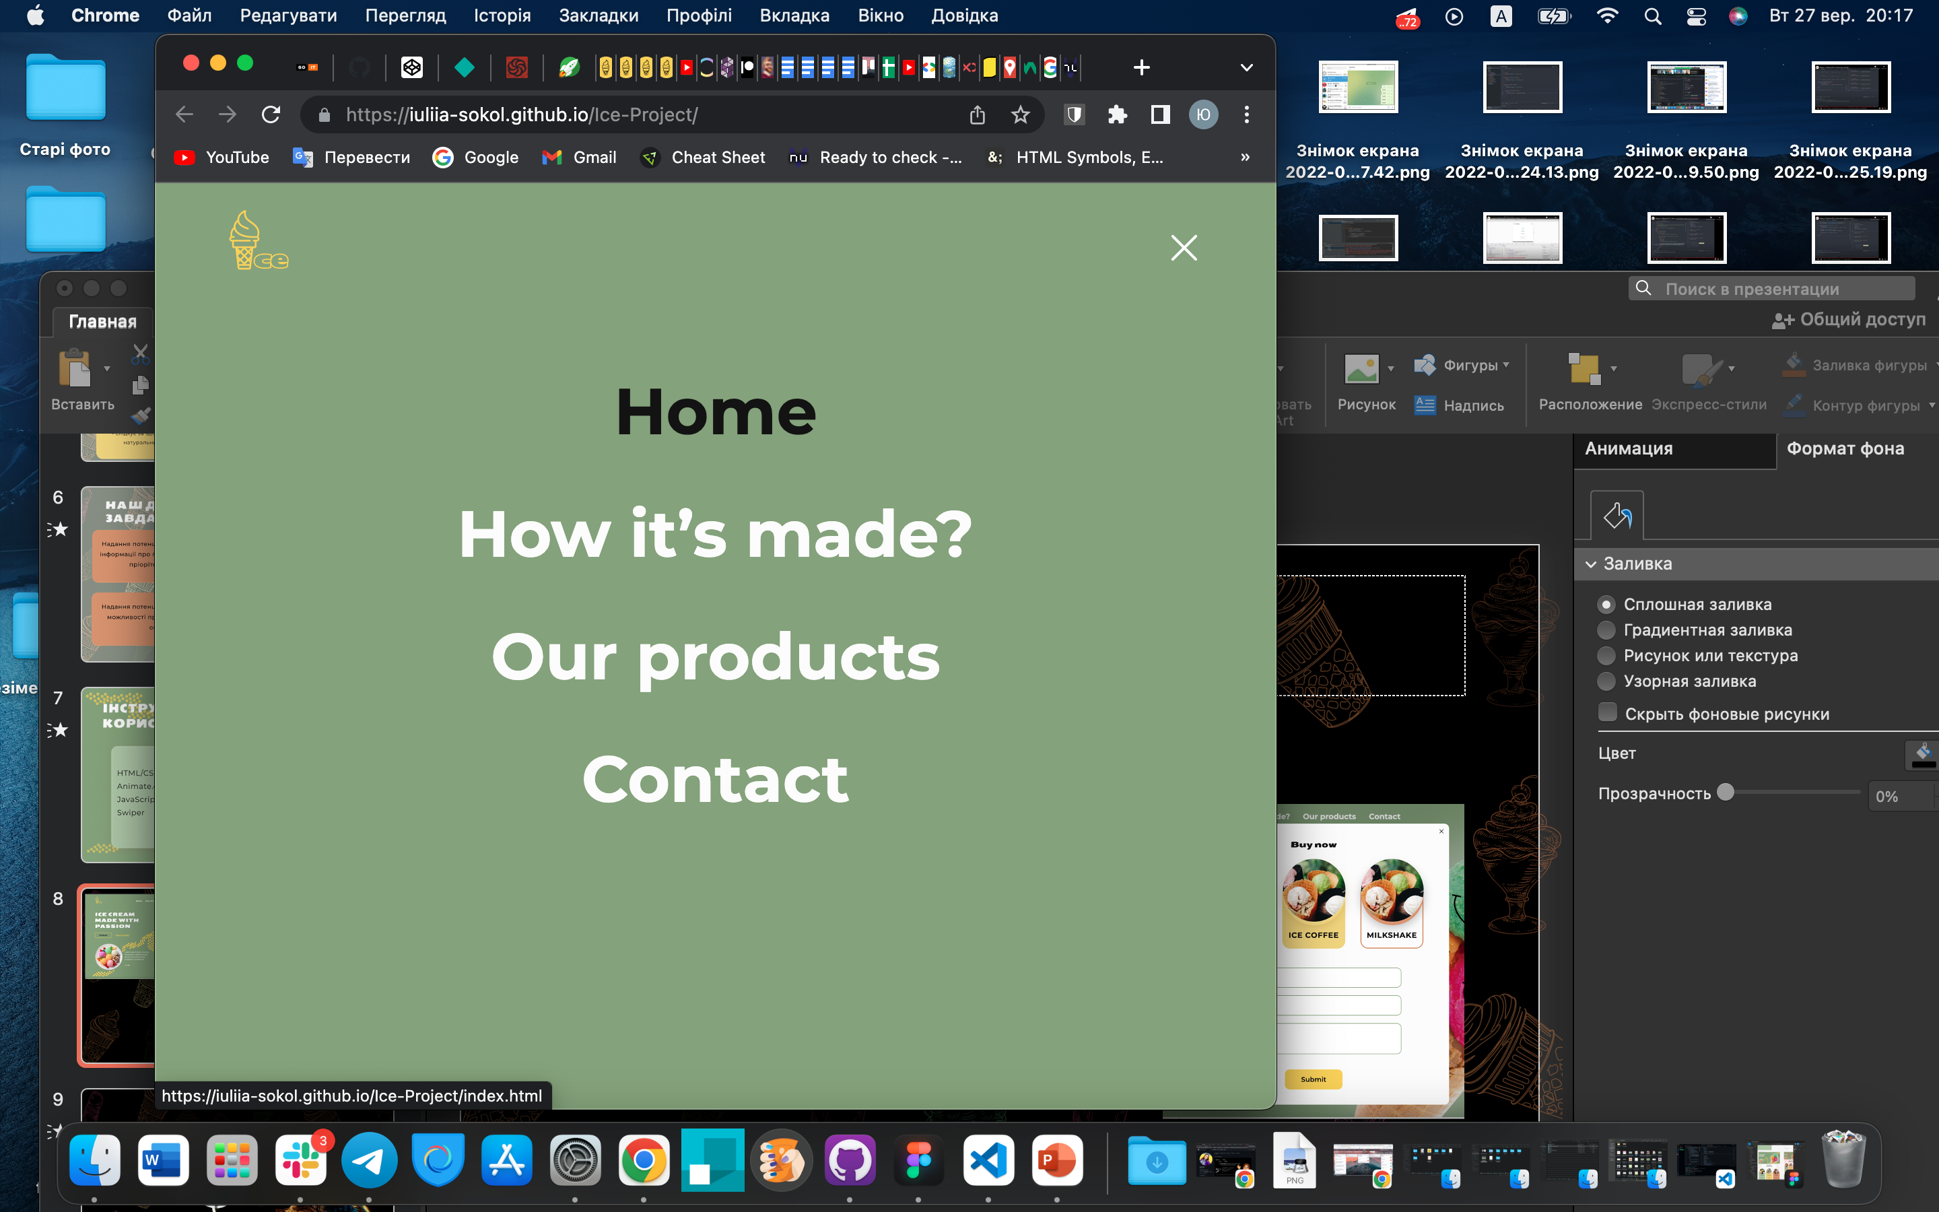
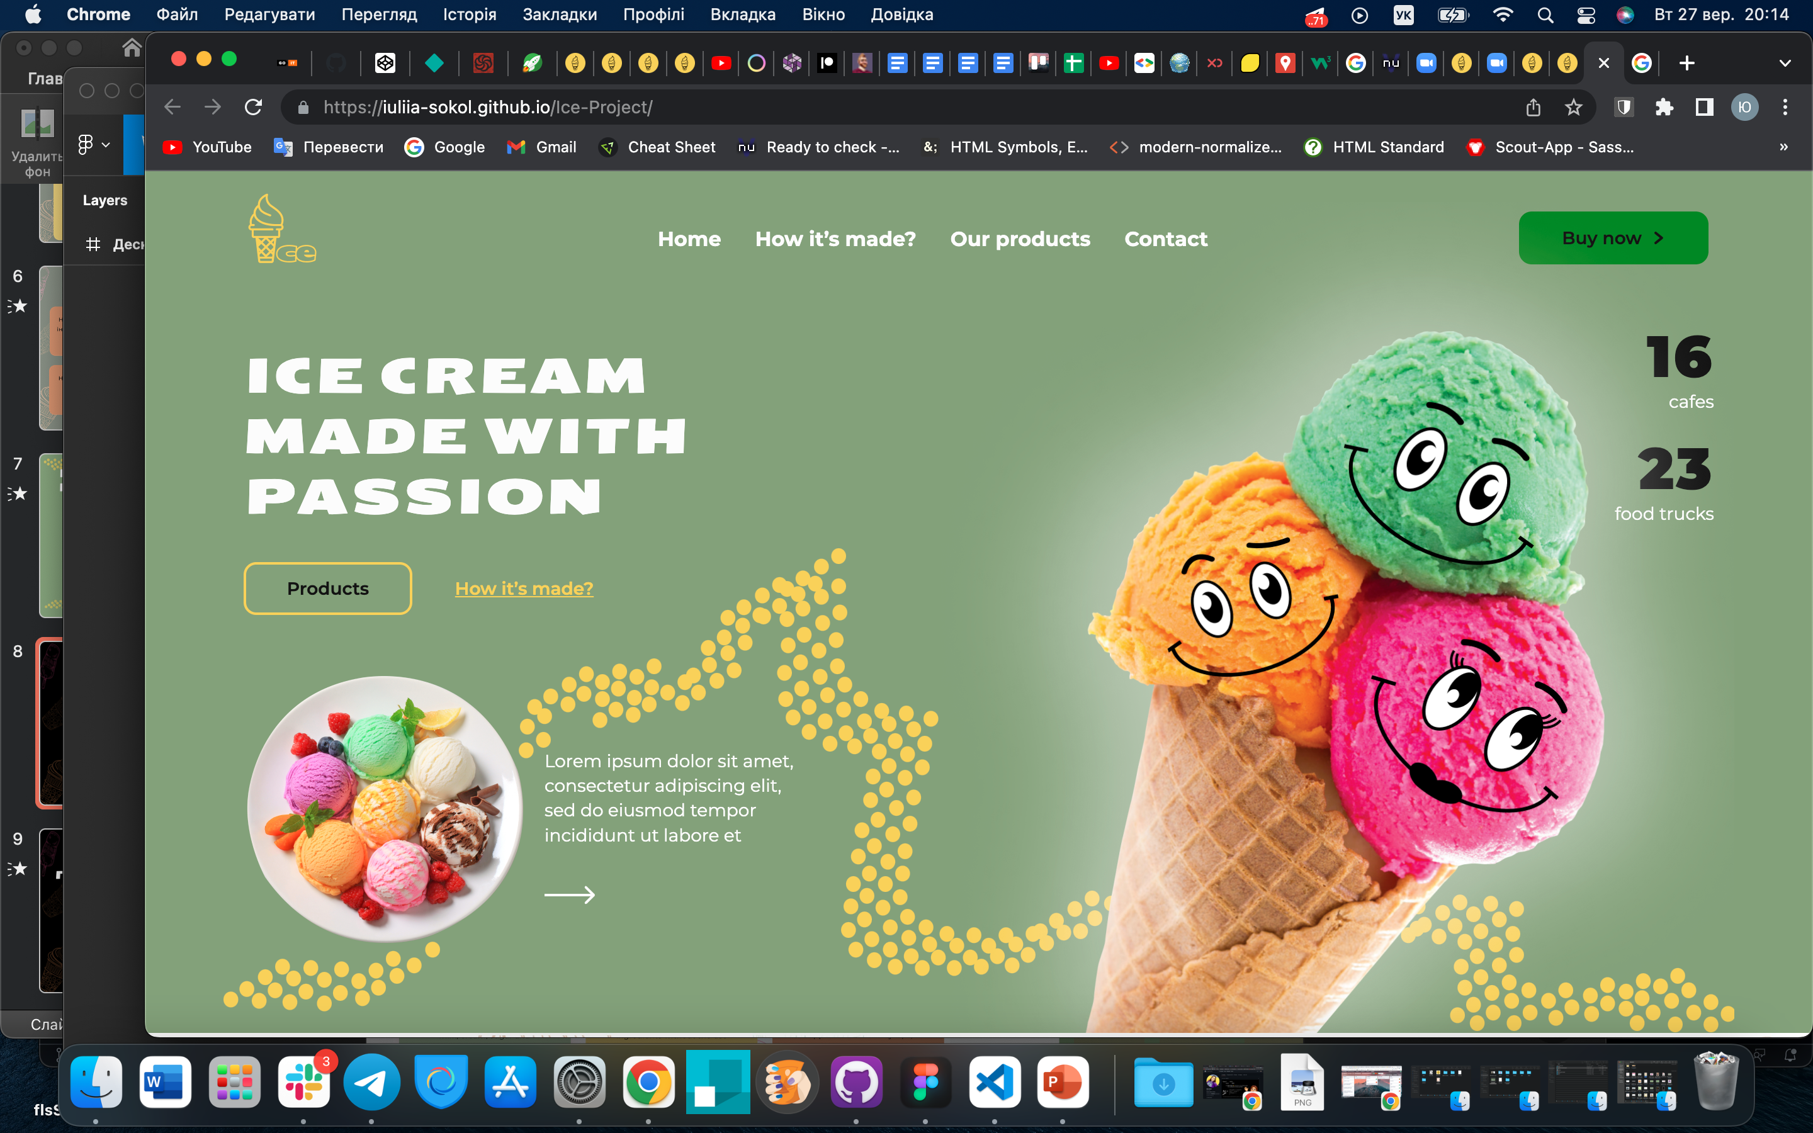
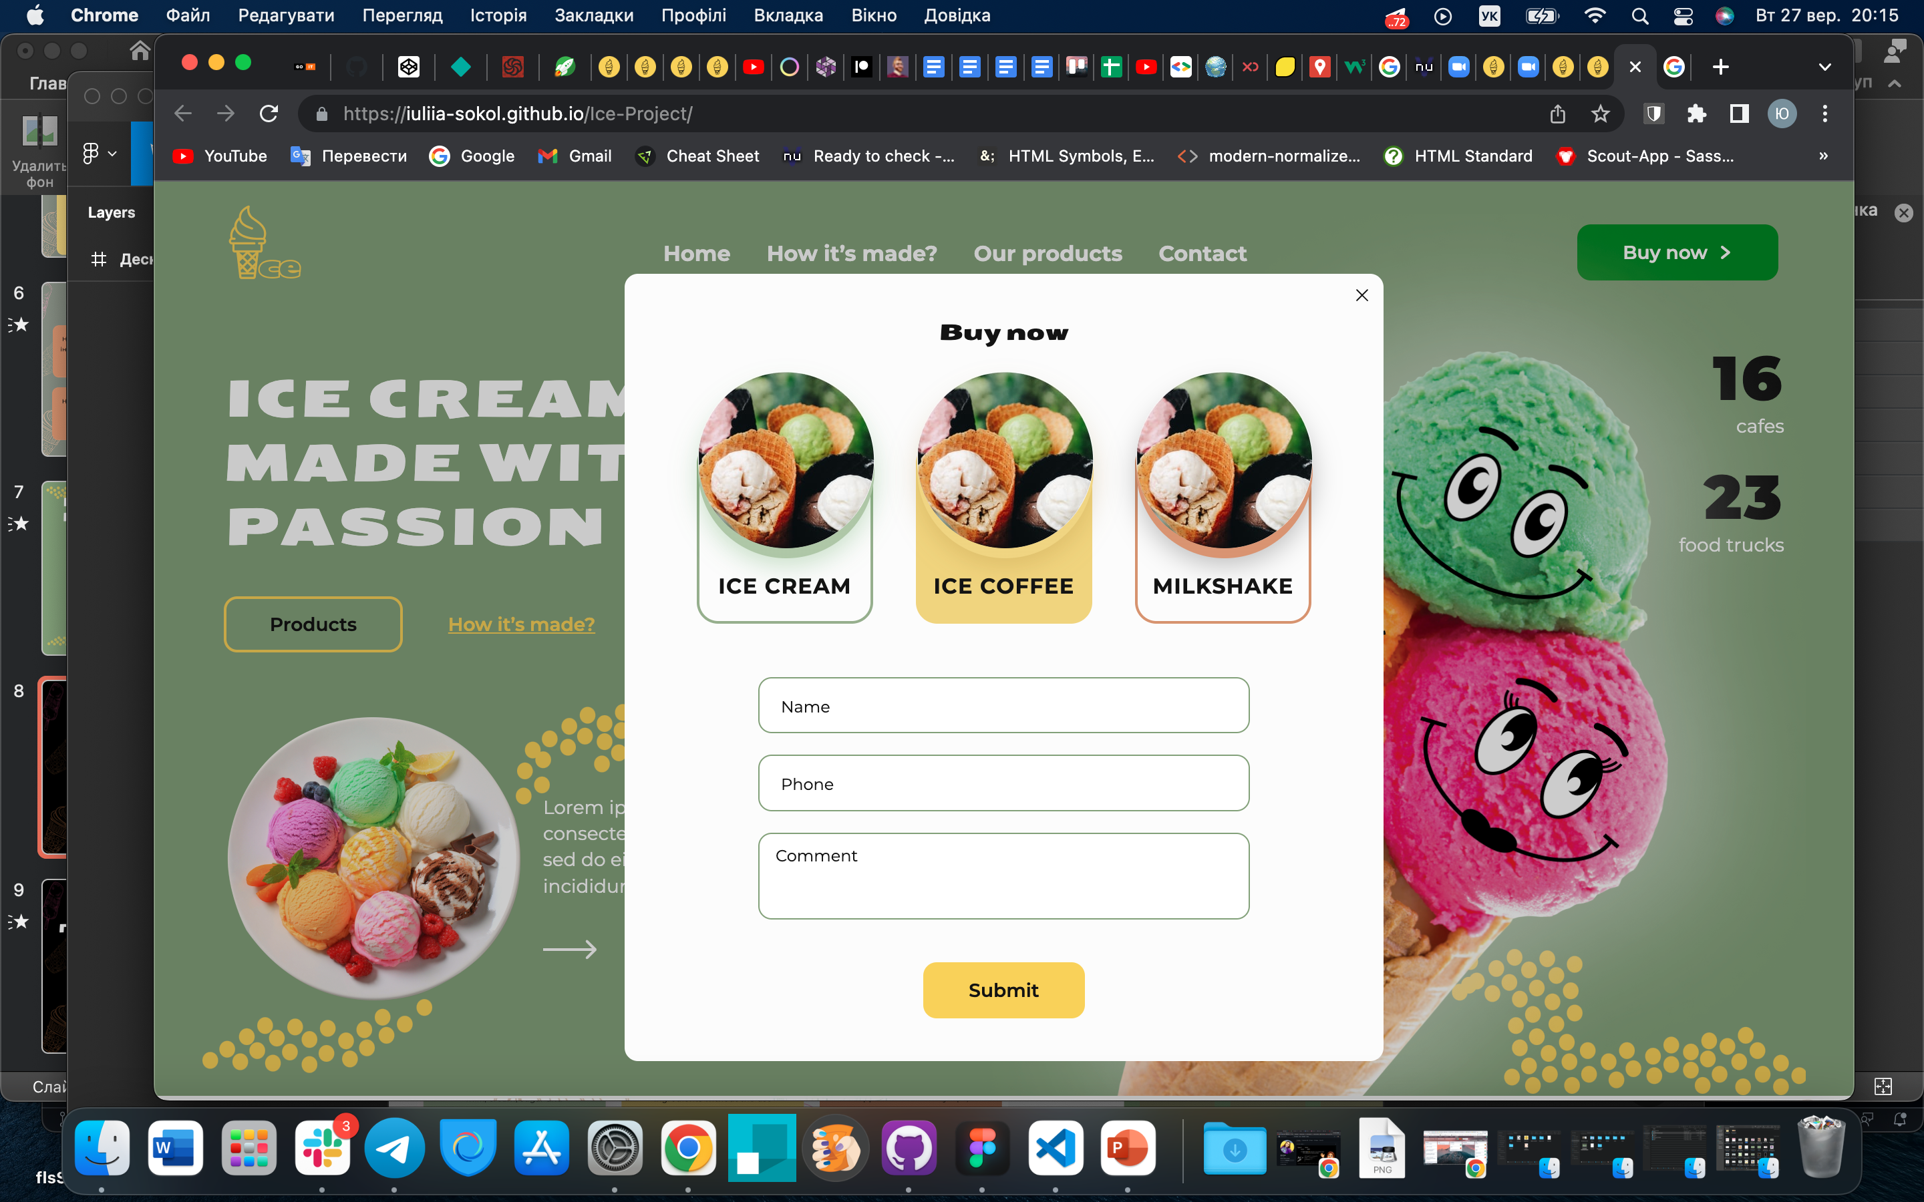
HEADER & HERO

Slide 9
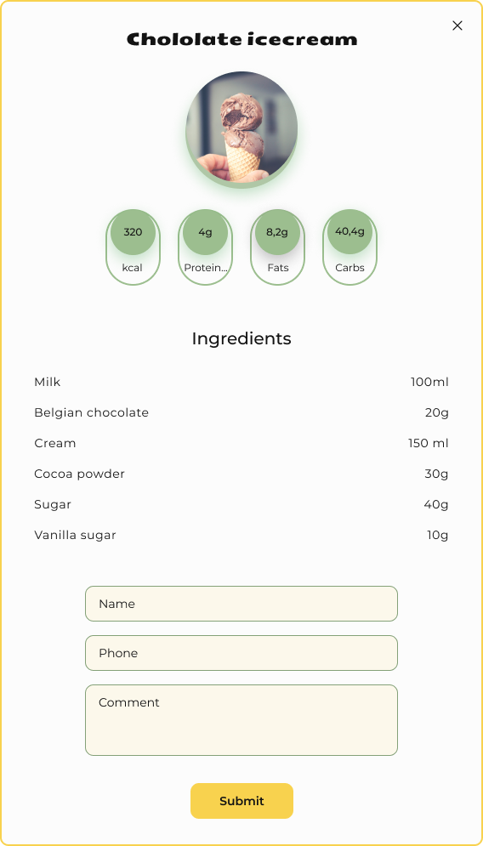
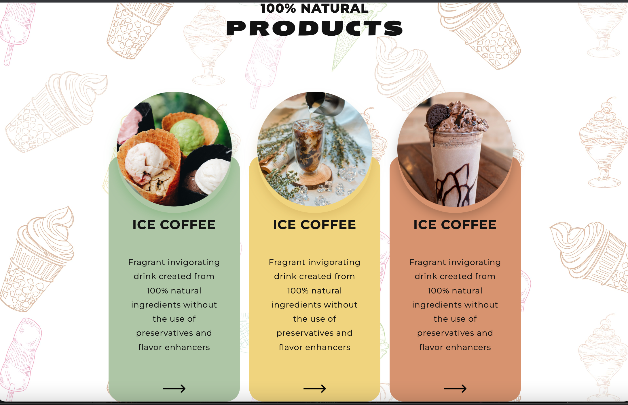
PRODUCTS

Slide 10
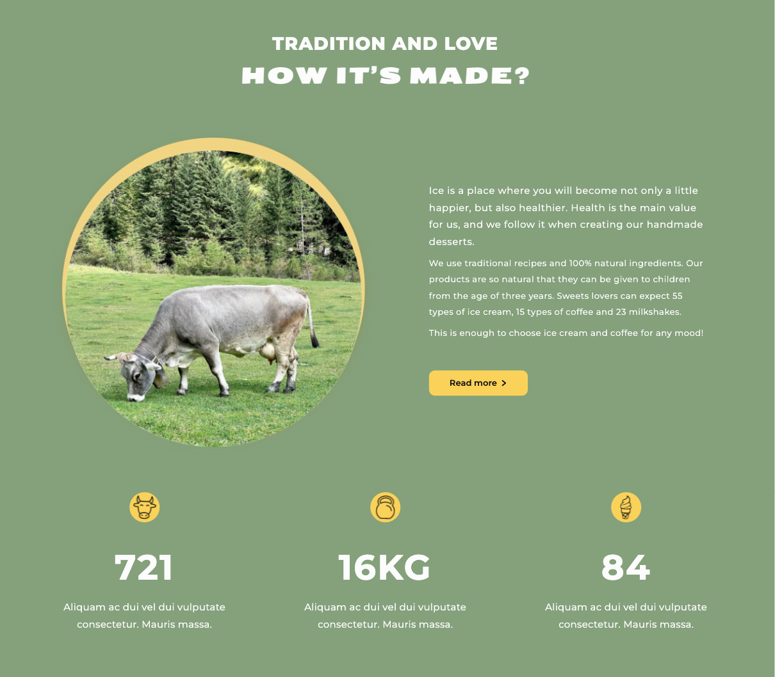
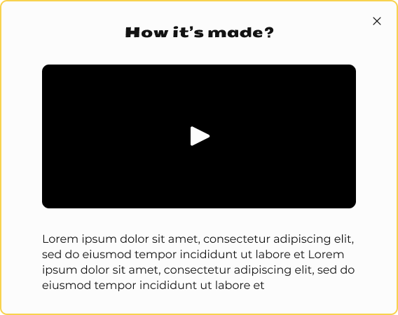
ABOUT & ADVANTAGES

Slide 11
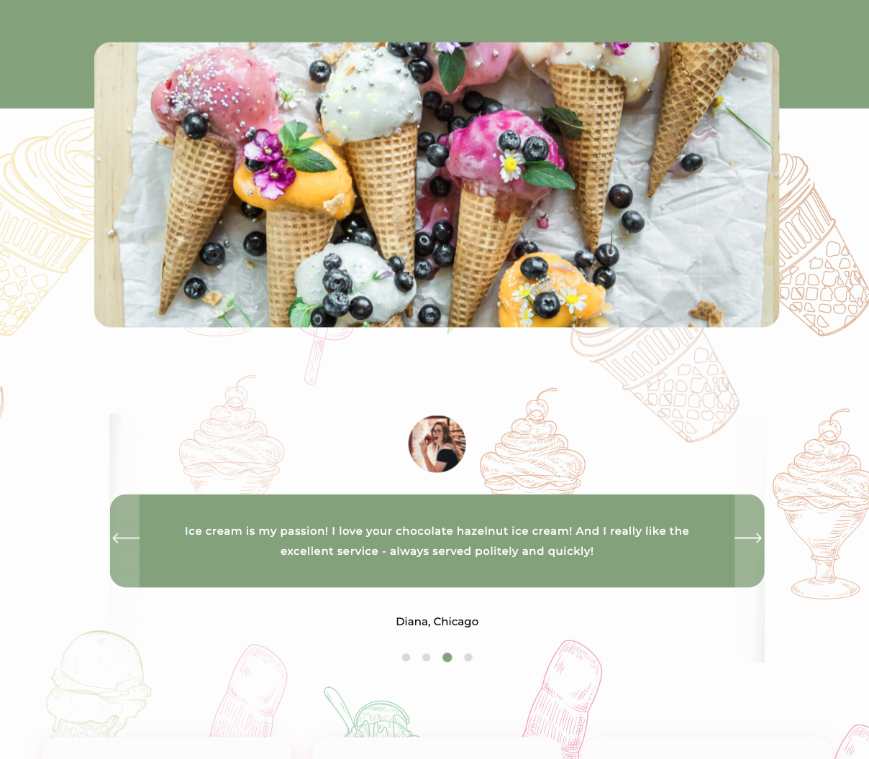
GALLERY & CUSTOMERS REVIEWS

Slide 12
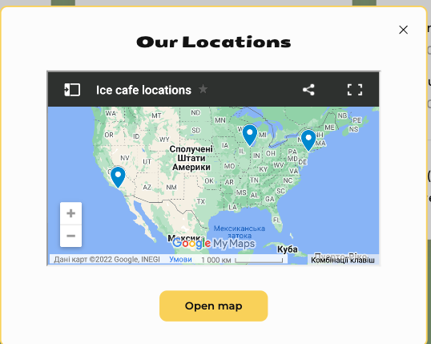
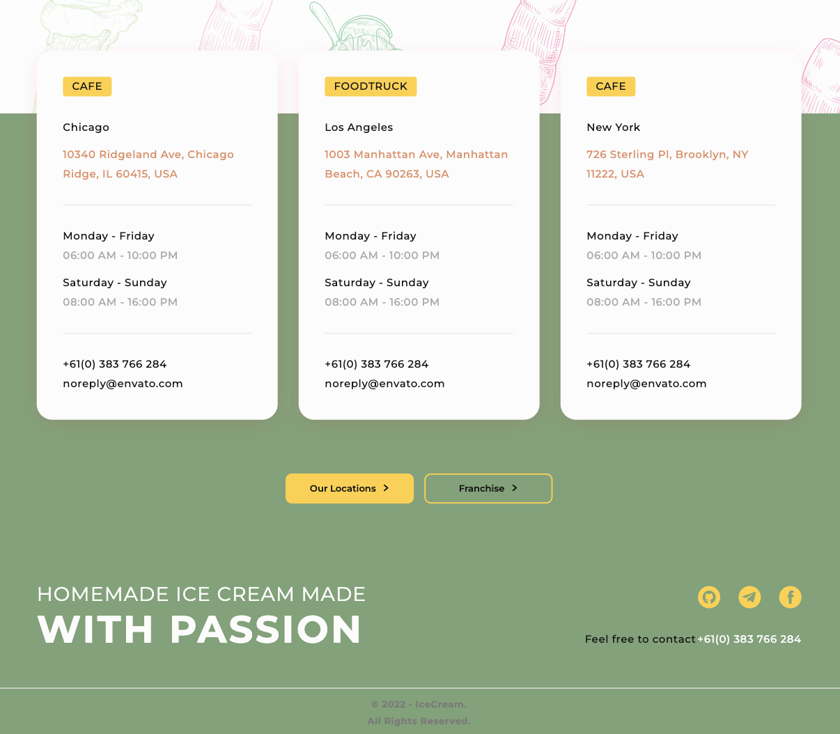
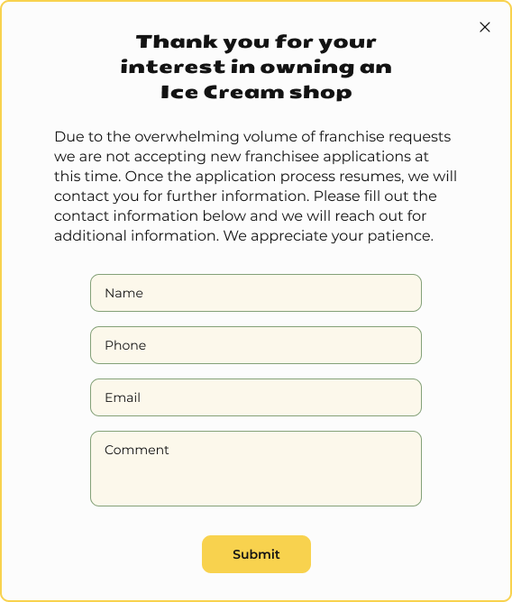
CONTACTS & FOOTER

Slide 13




Slide 14




